Slide 1
Data Warehousing
http://goo.gl/qRBY58
CS5200 DBMS
Bruce Chhay

Slide 2
Data Warehousing
L1. Data Warehousing and ETLs

Slide 3
Data Warehouse
Data storage repository used for making decisions.
Enables reporting for key metrics as well as ad-hoc analysis.
Decision making for: sales, marketing, business processes, budgeting, forecasting, financial reporting, etc.
Knowledge discovery: statistical model/inference, machine learning, etc.
Reporting: visualizations, dashboarding, alerting, etc.
Notes:
What

Slide 4
Data Warehouse
Data storage repository used for making business decisions.
Enables reporting for key metrics as well as ad-hoc analysis.
Decision making for: sales, marketing, business processes, budgeting, forecasting, financial reporting, etc.
Knowledge discovery: statistical model/inference, machine learning, etc.
Reporting: visualizations, dashboarding, alerting, etc.
Notes:
Why

Slide 5
Organizing Data
Pivot tables: summarization tool to re-organize data by aggregation and reducing variables.
Date | Location | Article | Price
4/1/2017 | Seattle | Jean Jacket | $100.00
4/1/2017 | Seattle | Khakis | $50.00
4/1/2017 | Bellevue | Cardigan | $60.00
4/2/2017 | Toronto | Flannel Shirt | $90.00
4/2/2017 | Toronto | Flannel Shirt | $80.00
4/2/2017 | Seattle | T-shirt | $30.00
4/2/2017 | Bellevue | Tie | $20.00
Notes:
How (example)
You can easily create a pivot table in your favorite spreadsheet application (Excel, Google Docs, Libra Office, etc.).

Slide 6
Organizing Data
Pivot tables: summarization tool to re-organize data by aggregation and reducing variables.
Date | Location | Article | Price
4/1/2017 | Seattle | Jean Jacket | $100.00
4/1/2017 | Seattle | Khakis | $50.00
4/1/2017 | Bellevue | Cardigan | $60.00
4/2/2017 | Toronto | Flannel Shirt | $90.00
4/2/2017 | Toronto | Flannel Shirt | $80.00
4/2/2017 | Seattle | T-shirt | $30.00
4/2/2017 | Bellevue | Tie | $20.00
Sum(Price) | Date
Location | 4/1/2017 | 4/2/2017 | Subtotal
Bellevue | $60.00 | $20.00 | $80.00
Seattle | $150.00 | $30.00 | $180.00
Toronto | $0.00 | $170.00 | $170.00
Subtotal | $210.00 | $220.00 | $430.00
Notes:
Aggregate price (group by Location, Date) and move unique date values into columns.

Slide 7
Organizing Data
Compare to SELECT aggregation
SELECT Location, Date, SUM(Price) AS Subtotal
FROM Sales
GROUP BY Location, Date WITH ROLLUP
ORDER BY Location, Date
Location | Date | Subtotal
Bellevue | 4/1/2017 | $60.00
Bellevue | 4/2/2017 | $20.00
Bellevue | NULL | $80.00
Seattle | 4/1/2017 | $150.00
Seattle | 4/2/2017 | $30.00
Seattle | NULL | $180.00
Toronto | 4/2/2017 | $170.00
Toronto | NULL | $170.00
NULL | NULL | $430.00
Date | Location | Article | Price
4/1/2017 | Seattle | Jean Jacket | $100.00
4/1/2017 | Seattle | Khakis | $50.00
4/1/2017 | Bellevue | Cardigan | $60.00
4/2/2017 | Toronto | Flannel Shirt | $90.00
4/2/2017 | Toronto | Flannel Shirt | $80.00
4/2/2017 | Seattle | T-shirt | $30.00
4/2/2017 | Bellevue | Tie | $20.00
Notes:
Differences: pivot table may be easier to read; has aggregation on date independent of location.
SELECT statement: if you want all dates, then use a LEFT OUTER JOIN with date dimension table on left-hand side of join.

Slide 8
Organizing Data
Compare to SELECT aggregation and handling each unique date as separate column.
Date | Location | Article | Price
4/1/2017 | Seattle | Jean Jacket | $100.00
4/1/2017 | Seattle | Khakis | $50.00
4/1/2017 | Bellevue | Cardigan | $60.00
4/2/2017 | Toronto | Flannel Shirt | $90.00
4/2/2017 | Toronto | Flannel Shirt | $80.00
4/2/2017 | Seattle | T-shirt | $30.00
4/2/2017 | Bellevue | Tie | $20.00
SELECT Location,
SUM(IF(Date=’2017-04-01’, Price, 0) AS ‘4/1/2017’,
SUM(IF(Date=’2017-04-02’, Price, 0) AS ‘4/2/2017’, SUM(Price) AS Subtotal
FROM Sales
GROUP BY Location WITH ROLLUP
Location | 4/1/2017 | 4/2/2017 | Subtotal
Bellevue | $60.00 | $20.00 | $80.00
Seattle | $150.00 | $30.00 | $180.00
Toronto | $0 | $170.00 | $170.00
NULL | $210.00 | $220.00 | $430.00
Notes:
Equivalent to a pivot table, but the query is difficult to construct since each unique Date value needs to be handled in SELECT clause.
Can be done programmatically by examining unique ‘Date’ values prior to return resultset. See next slide.

Slide 9
Organizing Data
Pivot support in MS SQL Server. https://docs.microsoft.com/en-us/sql/t-sql/queries/from-using-pivot-and-unpivot?view=sql-server-2017
Date | Location | Article | Price
4/1/2017 | Seattle | Jean Jacket | $100.00
4/1/2017 | Seattle | Khakis | $50.00
4/1/2017 | Bellevue | Cardigan | $60.00
4/2/2017 | Toronto | Flannel Shirt | $90.00
4/2/2017 | Toronto | Flannel Shirt | $80.00
4/2/2017 | Seattle | T-shirt | $30.00
4/2/2017 | Bellevue | Tie | $20.00
SELECT Location, Date, Price
FROM Sales PIVOT ( SUM(Price)
FOR Date IN ([4/1/2017], [4/2/2017])) AS PVT
ORDER BY Location
Location | 4/1/2017 | 4/2/2017
Bellevue | $60.00 | $20.00
Seattle | $150.00 | $30.00
Toronto | $0.00 | $170.00
Notes:
Note: pivot table has no “Subtotal” column or row; these can be added when using “SELECT FROM PIVOT” as the inner SELECT statement.

Slide 10
Organizing Data
Star schema:
Fact table: central table containing aggregate measures/metrics. Foreign key references to dimensions.
Dimension tables: dimensions are the granularity used to label the measures. Each dimension table contains the entire domain of values for that dimension.
CountryID | Country
1 | USA
2 | Canada
MonthID | Month
3 | March
4 | April
Sales | MonthID | CountryID | ArticleID
$50.00 | 3 | 1 | 1
$20.00 | 4 | 1 | 1
$900.00 | 3 | 2 | 1
$700.00 | 4 | 2 | 1
Compare to normalized (3NF) relational model: Star schema is easy to use and fast to query; if dependencies amongst non-prime attributes, then data inconsistency for updates. 3NF minimizes inconsistency/redundancy, relations and relationships are easier to update.
ArticleID | Article
1 | Flannel Shirt
Notes:
How (example)

Slide 11
Organizing Data
Multidimensional (OLAP) cubes: consists of measures and dimensions, where a measure is an aggregation described by a set of dimensions.
Flannel Shirts
USA
Canada
Sales: $50
Sales: $900
March
Sales: $20
Sales: $700
April
Limited to three dimensions for illustration purposes, but actually we have a lot more (for example, we can easily include year).
Notes:
Essentially a different way to represent a star-schema.
Allows you to create different data structures by “slicing” on a specific dimension. Examples:
* Sales for March in all items in all countries: top half of cube.
* Sales for USA for all items across all months: left half of cube. * Sales for all flannel shirts across all countries and months: front slice.
Different teams and reports can consume the slices. Increases data isolation (e.g. privacy) and performance.

Slide 12
Data Pipeline
ETL: extract, transform, load.
Extract from a source, transform according to business rules, load to data warehouse.
Sources
Extract & transform: prepare, cleanse, map
Load: Relational DB
ETL: Multidimensional cube
Reporting & Analysis

Slide 13
Tools
Microsoft SQL Server Business Intelligence (http://www.microsoft.com/en-us/server-cloud/solutions/business-intelligence/, http://www.microsoft.com/en-us/powerbi/default.aspx), HP Vertica (http://www.vertica.com/about/), IBM InfoSphere (http://www-03.ibm.com/software/products/en/category/SWP00), Informatica (www.informatica.com), Talend (http://www.talend.com/download), Tableau (http://public.tableau.com/s/), Pentaho (http://community.pentaho.com/), etc.

Slide 14
Data Warehousing
L2. Exercise 1: BlogApplication

Slide 15
Setup
Install CloverDX: https://www.cloverdx.com/trial-cloverdx
Documentation: https://learn.cloverdx.com/quickstart/
See “Quick Start Guide” and “Examples” in CloverETL Welcome page
Notes:
Mac OS Big Sur compatibility issues? See: https://support1.cloverdx.com/hc/en-us/articles/360017545060-Designer-incompatibility-with-macOS-Big-Sur
Install MySQL Server 5.X to be compatible with CloverETL. If MySQL Server 8.0, then you need CloverETL Designer edition (45-day trial) and then add your MySQL connector jar.
Clover ETL: http://www.cloveretl.com/learn/quickstart/

Slide 16
Exercise 1: BlogApplication
Goal: how many BlogPosts are created per day, and are there any trends?

Slide 17
Exercise 1: BlogApplication
Let’s seed the data first.
Recreate the model: http://goo.gl/86a11H
Run:
USE BlogApplication;
INSERT INTO Persons(UserName,FirstName,LastName) VALUES('foo','first','last');
INSERT INTO BlogUsers(UserName,DoB,StatusLevel) VALUES('foo','1990-04-01','novice');
INSERT INTO BlogPosts(Title,Content,Published,UserName,Created) VALUES('cats1','cats',True,'foo','2016-11-18 01:00:00');
INSERT INTO BlogPosts(Title,Content,Published,UserName,Created) VALUES('cats2','cats',True,'foo','2016-11-19 01:00:00');
INSERT INTO BlogPosts(Title,Content,Published,UserName,Created) VALUES('cats3','cats',True,'foo','2016-11-19 01:00:00');
INSERT INTO BlogPosts(Title,Content,Published,UserName,Created) VALUES('cats4','cats',True,'foo','2016-11-20 01:00:00');
INSERT INTO BlogPosts(Title,Content,Published,UserName,Created) VALUES('cats5','cats',True,'foo','2016-11-20 01:00:00');
INSERT INTO BlogPosts(Title,Content,Published,UserName,Created) VALUES('cats6','cats',True,'foo','2016-11-20 01:00:00');
INSERT INTO BlogPosts(Title,Content,Published,UserName,Created) VALUES('cats7','cats',True,'foo','2016-11-20 01:00:00');
INSERT INTO BlogPosts(Title,Content,Published,UserName,Created) VALUES('cats8','cats',True,'foo','2016-11-20 01:00:00');
DROP TABLE IF EXISTS DWPost;
CREATE TABLE DWPost (DWPostId INT AUTO_INCREMENT,Created DATE,Count INT,CONSTRAINT pk_DWPost_DWPostId PRIMARY KEY (DWPostId));

Slide 18
Exercise 1: BlogApplication
Similar to “Accessing a Database” example
Should be DatabaseAccess.grf under RealWorldExamples > graph
Create a new CloverETL Project, new ETL Graph (MySql.grf)
Add Readers > DBInputTable
Configure new connection (and validate!) (URL: jdbc:mysql://localhost:3306/BlogApplication)
Build the query (and validate) (SELECT BlogPosts.Created FROM BlogPosts)
Extract Metadata (Set delimiter, format timestamp to date “MM/dd/yyyy”)

Slide 19
Exercise 1: BlogApplication
Add Transformers > Aggregate
Add Writers > Trash
Debug print: true
Add edge and create metadata (Aggregate output fields).
Add Created (date) and Count (integer) fields
Update Aggregate properties
Aggregate key: Created
Aggregation mapping: $Created:=$Created;$Count:=count(); (Also check out the mapping builder)
Click “?” for more details
Save, run, and view output!

Slide 20
Exercise 1: BlogApplication
Add Writers > SpreadsheetDataWriter
Add edge from Aggregate to SpreadsheetDataWriter
File URL: data-out/BlogPosts.xlsx
Sheet: Sheet0
Mapping: use builder
Write mode: overwrite
Existing sheets: replace
Save, run, and view XLSX.
Format Created to Date
Create a chart
Trend?
Notes:
BAK: https://docs.google.com/spreadsheets/d/1VHVHGh5JiII8ZbLd6PJMNytZp7MwJyIGygHdH1nmS3A/edit#gid=1374395655

Slide 21
Exercise 1: BlogApplication
Add Writers > DBOutputTable
Add edge from Aggregate to DBOutputTable.
DB Connection: re-use the MySQL connection
DB Table: DWPost
Field Mapping: use builder ($Created:=Created;$Count:=Count;)
Save, run, and view DWPost table.
What other dimensions can we add?
What if we run this nightly?

Slide 22
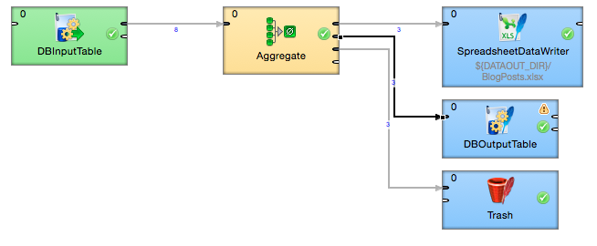
Exercise 1

Slide 23
Data Warehousing
L3. Exercise 2: Bike Weather

Slide 24
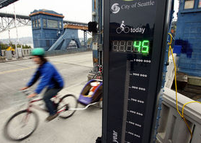
Exercise 2: Bike Weather
Goal: does temperature affect bike crossings on the Fremont Bridge?
seattletimes.com - Fremont bridge bike counter

Slide 25
Exercise 2: Bike Weather
Download the data (as CSV):
Bike count: https://data.seattle.gov/Transportation/Fremont-Bridge-Hourly-Bicycle-Counts-by-Month-Octo/65db-xm6k
Weather: https://data.seattle.gov/Transportation/Road-Weather-Information-Stations/egc4-d24i
Filter StationName “AuroraBridge”
Also available at: https://drive.google.com/file/d/0B_4dGvIEciEYME9FTmR3TF81aFk/view?usp=sharing
Open the CSVs to understand the format.
How can they be combined?
Bike, 2015 Oct - 2012 Oct, Hour. (27K records)
Weather, 2015 Nov - 2014 Mar, Minute. (1M records)
2015 Oct - 2014 Mar, Hour; AirTemperature vs. E+W Bike

Slide 26
Exercise 2: Bike Weather
Similar to “Joining & Aggregating” example
Should be Joining_Aggregating.grf under RealWorldExamples > graph
Create a new ETL Graph (BikeWeather.grf)
Move CSV files to data-in directory.

Slide 27
Exercise 2: Bike Weather
Add Readers > UniversalDataReader
File URL: data-in/Bikes.csv
Data Policy: Lenient
Trim Strings: true
Quoted Strings: false
(Max number of records: - useful for debugging, use 15K)
Skip first line: true

Slide 28
Exercise 2: Bike Weather
Add Readers > UniversalDataReader
File URL: data-in/Weather.csv
Data Policy: Lenient
Trim Strings: true
Quoted Strings: true
Quote character: "
(Max number of records: - useful for debugging, use 100K)
Skip first line: true

Slide 29
Exercise 2: Bike Weather
UniversalDataReader (Bikes.csv) > Extract Metadata
Use the builder to view and parse data from CSV
Change “Date” field to date data type
Change format to “MM/dd/yyyy hh:mm:ss a”
Java date time symbols: https://docs.oracle.com/javase/8/docs/api/java/time/format/DateTimeFormatter.html
Change bike count fields to “West” and “East”
Verify parsed data looks correct!

Slide 30
Exercise 2: Bike Weather
UniversalDataReader (Weather.csv) > Extract Metadata
Use the builder to view and parse data from CSV
Change Quote char to " and click “Reparse”
Change “DateTime” field to date data type
Change format to “MM/dd/yyyy hh:mm:ss a”
Java date time symbols: https://docs.oracle.com/javase/8/docs/api/java/time/format/DateTimeFormatter.html
Verify parsed data looks correct!

Slide 31
Exercise 2: Bike Weather
Add 2X Writers > Trash
Debug print: true
Add edges and use the created metadata
Set UnversalDataReader Max number of records: 100
Save, run, and view output

Slide 32
Exercise 2: Bike Weather
Add Joiners > ExtHashJoin
Add edges and use the created metadata
Add Writers > Trash
Debug print: true
Add edge and create metadata (metadata can be created from ExtHashJoin, too).
Date date (format: “MM/dd/yyyy hh:mm:ss a”)
BikeCount integer
AirTemperature decimal
Set delimiter to “,”

Slide 33
Exercise 2: Bike Weather
Update ExtHashJoin properties
Join key: use builder to map Date and DateTime ($Date=$DateTime)
Join type: inner join
Transform: use builder to map:
Date -> Date (safe: nvl($in.0.Date, createDate(2015,1,1)))
West + East -> BikeCount (safe: nvl($in.0.West,0) + nvl($in.0.East,0))
AirTemperature -> AirTemperature (safe: nvl($in.1.AirTemperature,0.0))
Set Bike/Weather Max number of records: 15,000/100,000
Or gradually turn up the volume until you view output
Save, run, and view output

Slide 34
Exercise 2: Bike Weather
Create a DW table to store results Use BlogApplication; DROP TABLE IF EXISTS BikeWeather; CREATE TABLE BikeWeather(BikeWeatherId INT AUTO_INCREMENT, Date TIMESTAMP, BikeCount INT, AirTemperature DECIMAL, CONSTRAINT pk_BikeWeather_BikeWeatherId PRIMARY KEY (BikeWeatherId));
Add Writer > DBOutputTable
Add edge from ExtHashJoin to DBOutputTable.
DB Connection: re-create the MySQL connection
DB Table: BikeWeather
Field Mapping: use builder ($Date:=Date;$BikeCount:=BikeCount;$AirTemperature:=AirTemperature;)

Slide 35
Exercise 2: Bike Weather
Now create phase 1 to read from table and generate report
Add Reader > DBInputTable
DB Connection: re-use the MySQL connection
SQL Query: use the builder? SELECT Date, BikeCount, AirTemperature FROM BlogApplication.BikeWeather ORDER BY Date
Phase: 1
Extract metadata
Set delimiter to “,”

Slide 36
Exercise 2: Bike Weather
Add Writer > SpreadsheetDataWriter
Add edge from DBInputTable to SpreadsheetDataWriter
File URL: data-out/BikeWeather.xlsx
Sheet: Sheet0
Mapping: use builder
Write mode: overwrite
Existing sheets: clear target sheet
Phase: 1
Save, run, and generate chart!
Format date if necessary
Conclusive?
Notes:
BAK: https://docs.google.com/spreadsheets/d/1EmMcuItfN3d0Ue085pF4E3M98OWa-Yp-pxXf6m8Fg3E/edit#gid=128042576

Slide 37
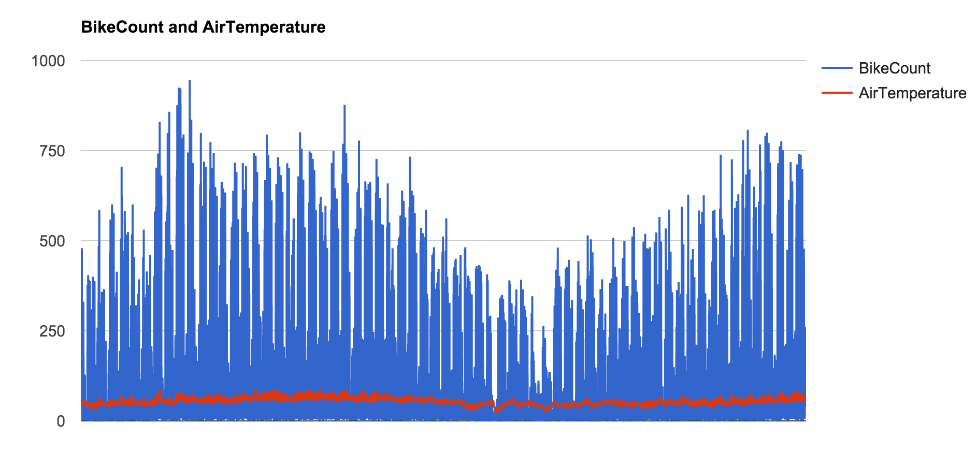
Exercise 2: Bike Weather
Notes:
BAK: https://docs.google.com/spreadsheets/d/1EmMcuItfN3d0Ue085pF4E3M98OWa-Yp-pxXf6m8Fg3E/edit#gid=128042576

Slide 38
Exercise 2: Bike Weather
Now create phase 2 to clean up the results
Total bike count per day; Max weather * 100
Add Reader > DBInputTable
DB Connection: re-use the MySQL connection
SQL Query: use the builder? SELECT Date(Date) AS Day, SUM(BikeCount) AS TotalBikes, MAX(AirTemperature)*100 AS MaxWeather100 FROM BlogApplication.BikeWeather GROUP BY Date(Date) ORDER BY Day
Phase: 2
Extract metadata
Set delimiter to “,”

Slide 39
Exercise 2: Bike Weather
Add Writer > SpreadsheetDataWriter
Add edge from DBInputTable to SpreadsheetDataWriter
File URL: data-out/BikeWeather.xlsx
Sheet: Sheet1
Mapping: use builder
Write mode: overwrite
Existing sheets: clear target sheet
Phase: 2
Drop & recreate BikeWeather table each time before running
Save, run, and generate chart!
Format date if necessary

Slide 40
Exercise 2: Bike Weather
Update UnversalDataReader
Remove Max number of records to parse full data source
You might run out of memory… process incrementally and/or continue to use Max number records (e.g. 800K for weather)
Drop & recreate BikeWeather table each time before running
Save, run, and generate chart!
Format date if necessary
How do the results look now?
Notes:
BAK: https://docs.google.com/spreadsheets/d/1EmMcuItfN3d0Ue085pF4E3M98OWa-Yp-pxXf6m8Fg3E/edit#gid=1888428043

Slide 41
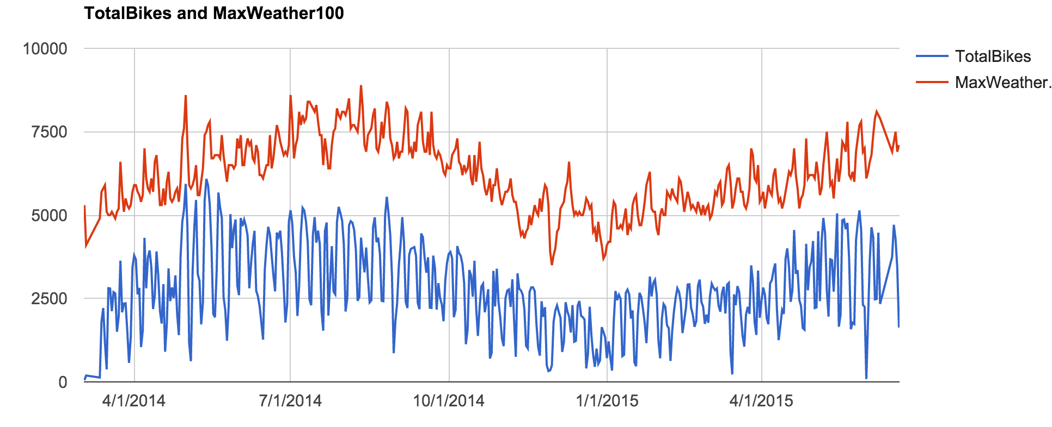
Exercise 2: Bike Weather
Notes:
BAK: https://docs.google.com/spreadsheets/d/1EmMcuItfN3d0Ue085pF4E3M98OWa-Yp-pxXf6m8Fg3E/edit#gid=1888428043

Slide 42
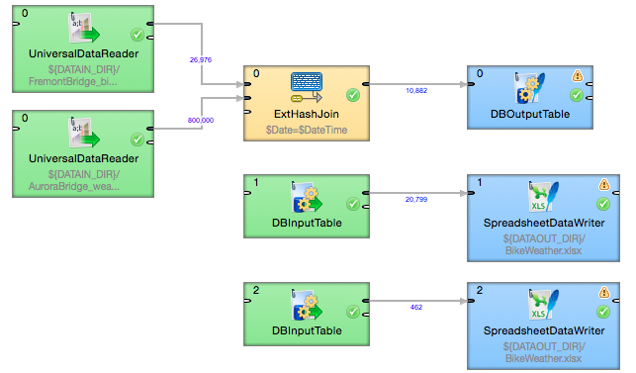
Exercise 2: Bike Weather

Slide 43
New Models
What happens when you have more data than you can process in an ETL and store in a data warehouse?
What if the structure of the data is always changing?
What if you want to process data real-time?

Slide 44
Data Warehousing
Discussion: PM5

Slide 45
PM5
Project Milestone 5: find two external data sources that can provide value when combined with your data.
Examples:
City of Seattle: https://data.seattle.gov
Socrata: http://www.opendatanetwork.com/, http://www.socrata.com/customer-stories/
Government Open Data: http://www.data.gov/
Health Data: http://www.healthdata.gov/, http://www.who.int/gho/database/en/
Global socio-economic data: https://data.worldbank.org/data-catalog
Kaggle: https://www.kaggle.com/
Notes:
More examples from aggregation sites, like http://www.google.com/publicdata/directory.

